Slide 1
Computer Vision
By:
Venkat Narayan TL
Pranav AS
Prathyush Govind KP
RS Vijaysuraj

Slide 2
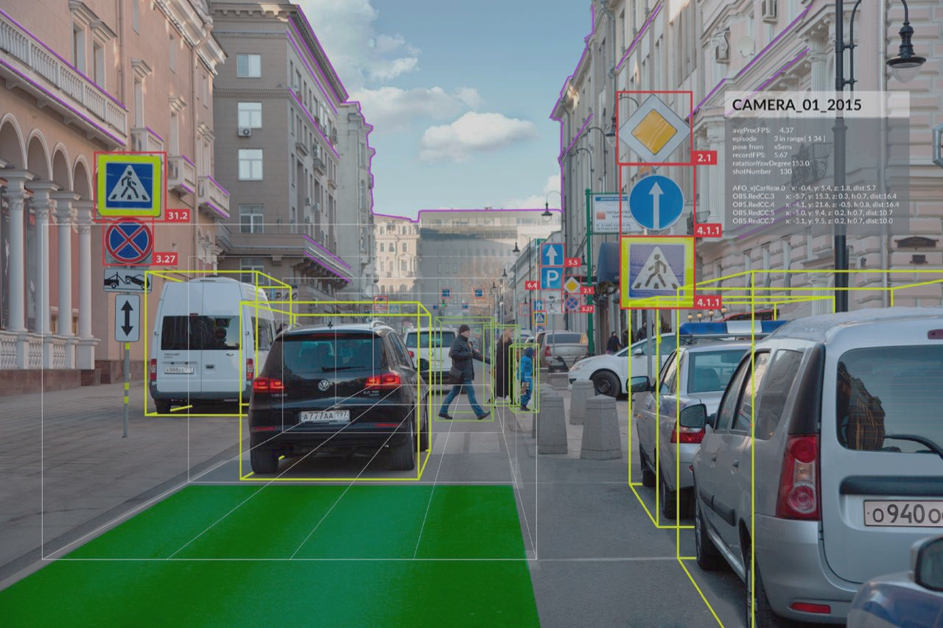
What is Computer Vision?
Computer vision(CV) is the subcategory of Artificial Intelligence (AI).
It focuses on building and using digital systems to process, analyze and interpret visual data.
Computer vision's aim is to enable computers to perform the same kind of tasks as humans with the same efficiency.

Slide 3
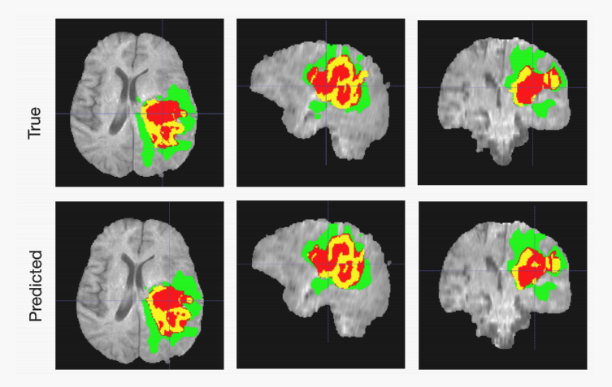
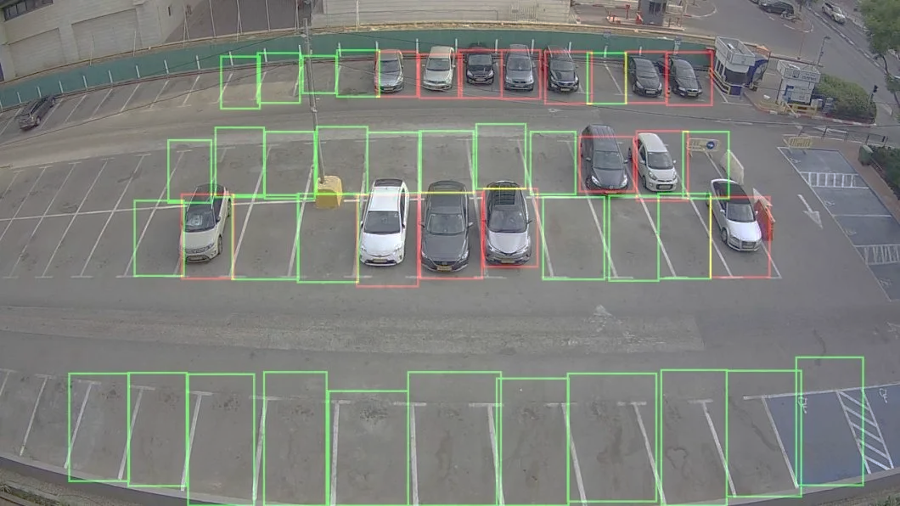
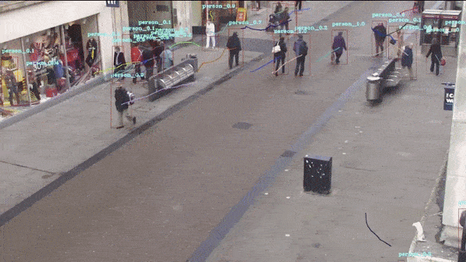
Uses of Computer Vision
Computer Vision is vastly used in many different fields, But its use is becoming more prominent in the following:
Healthcare
Parking Lots
Retail

Slide 4
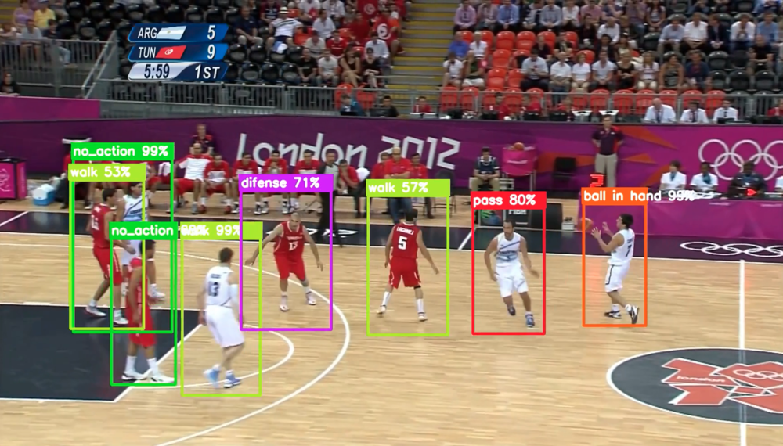
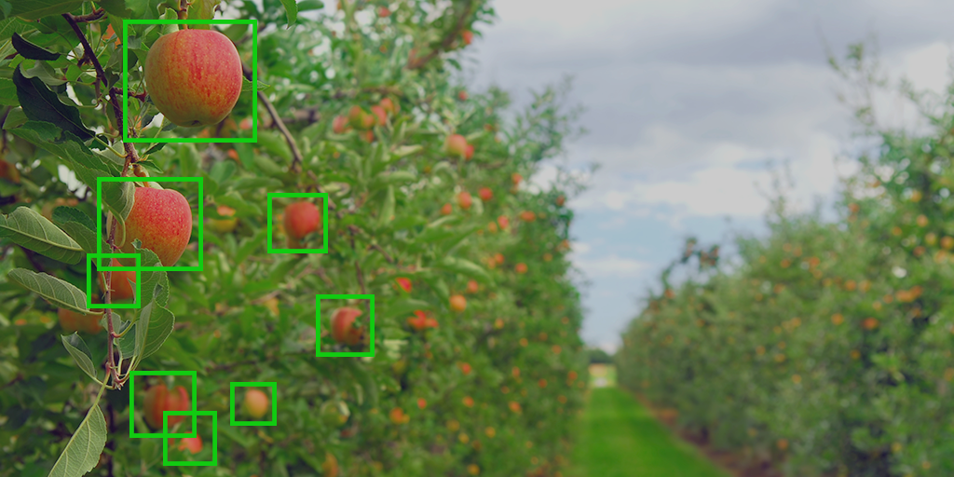
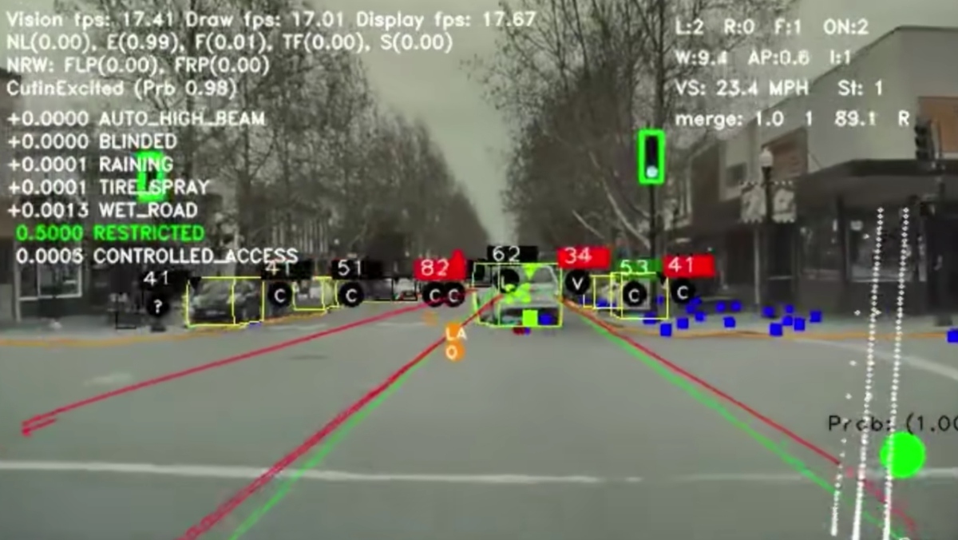
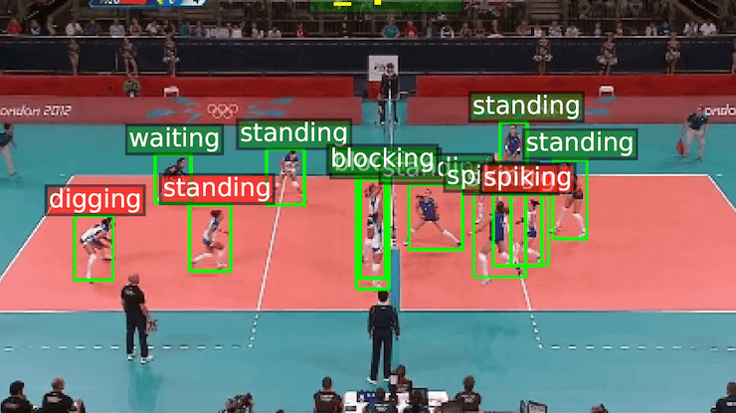
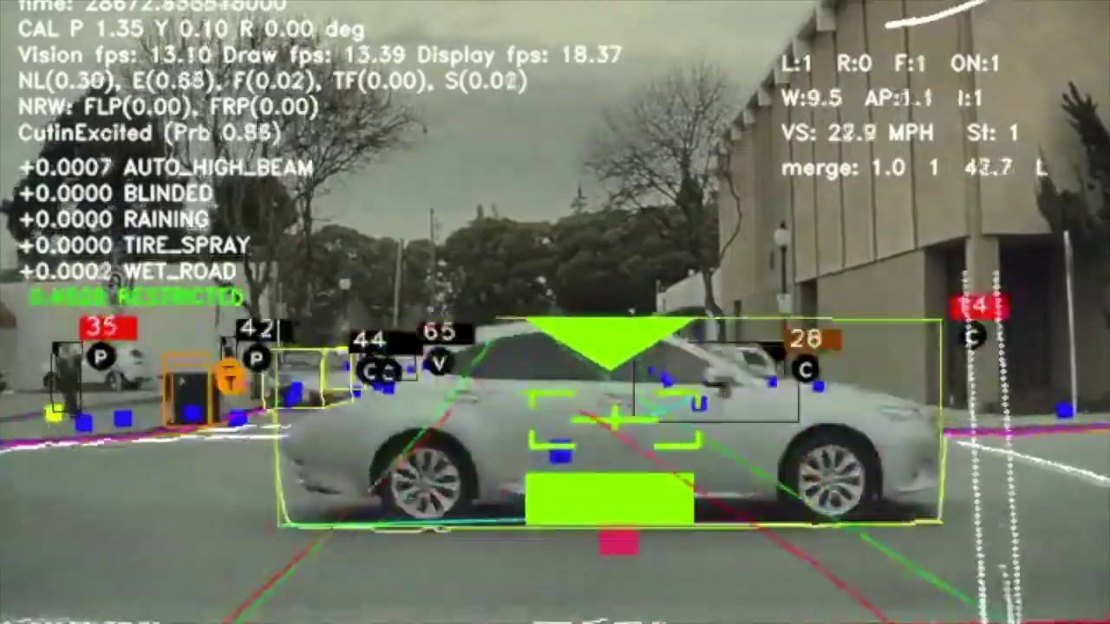
Uses of Computer Vision
Sports
Agriculture
Self-driving cars

Slide 5
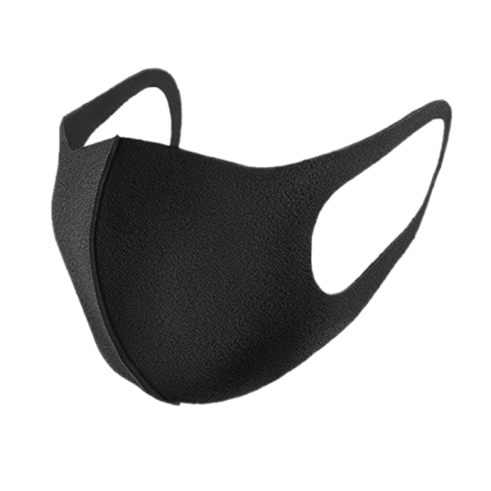
Face Mask Detection Using Computer Vision

Slide 6


Face Mask Detection Using Computer Vision
Step 1 : Detecting Faces

Slide 7


Face Mask Detection Using Computer Vision
Step 2 : Teaching the Computer What a Mask is:
Step 2.1 : Taking photos with a mask
Step 2.2 : Taking photos without a mask

Slide 8
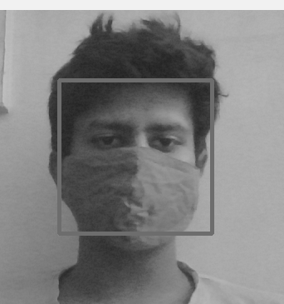
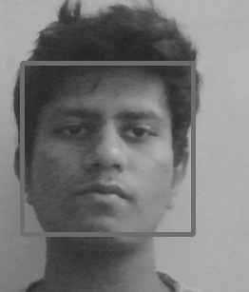
Face Mask Detection Using Computer Vision
Step 3 : Running it through an AI algorithm which learns the difference
difference

Slide 9
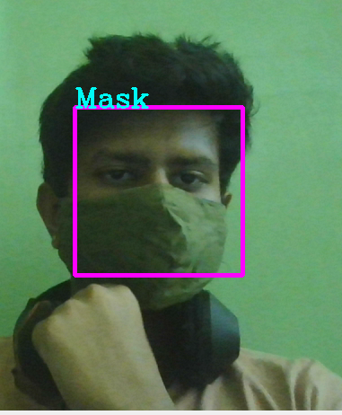
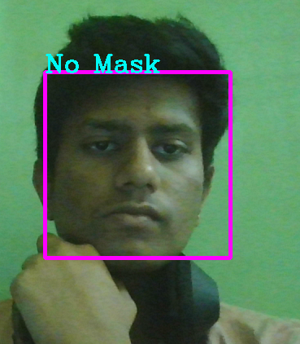
Face Mask Detection Using Computer Vision
Step 4 : Testing

Slide 10
Face Mask Detection Using Computer Vision
Uses:
The Face Mask Detection System can be used at office premises to detect if employees are maintaining safety standards at work. It monitors employees without masks and sends them a reminder to wear a mask.

Slide 11
THANK YOU

